Slide 1


Property, plant & Equipment (IAS 16 PPE)

Slide 2





Contents
Introduction to IAS 16
Scope and definitions
Recognition criteria
Initial measurement
Subsequent measurement
Depreciation and useful life
Impairment and derecognition
Disclosure requirements
Amendment to ISA 16

Slide 3
Introduction to IAS 16
IAS 16 is an International Accounting Standard issued by the International Accounting Standards Board (IASB). It provides guidance on the recognition, measurement, depreciation, derecognition and disclosure of property, plant and equipment (PPE) in financial statements.
The objective of the standard is to provide relevant information about entity’s investment in PPE and related changes

Slide 4
Introduction to IAS 16
IAS 16
What
Definition
Recognition
How much
Carrying amount
Depreciation
Derecognition

Slide 5
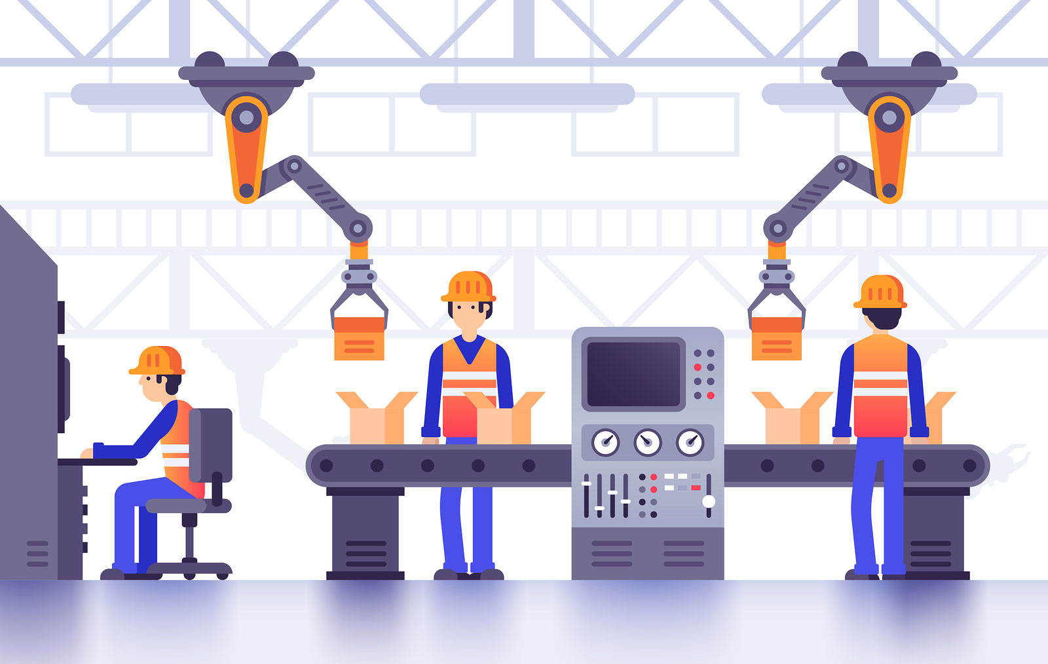


Scope and definitions
IAS 16 Property, Plant and Equipment is applied to
tangible assets held by an enterprise for more than one accounting period for use in the production or supply of goods or services, for rental to others or for administrative purposes.
Exception:
Land or building that is rented to others. (IAS 40)
Assets held for sale (IFRS 5)
Biological assets (IAS 41)
Exploration assets (IFRS 6)

Slide 6
Scope and definitions
Key terms:
Cost
Carrying amount
Depreciation
Residual value
Useful life

Slide 7
Recognition criteria
An item is recognized as PPE if
It is probable that future economic benefits will flow to the entity; and
The cost of the item can be measured reliably.

Slide 8
Initial measurement
PPE is Initially measured at cost (amount paid to buy).
Cost includes all the costs to get the asset ready for use:
1. Purchase price, less discounts
2. Import duties and non-refundable taxes
3. Installation and construction costs
4. Directly attributable costs (installation, delivery, professional fees)
5. Estimated cost of required removal or restoration.

Slide 9
Subsequent measurement
Reporting entities have the choice of:
1. THE COST MODEL
Carrying amount = cost less accumulated depreciation and impairment
2. THE REVALUATION MODEL
Carrying amount = fair value at revaluation date less subsequent depreciation and impairment.
Revaluations must be regular enough to approximate fair value

Slide 10
Depreciation and useful life
Depreciation is charged systematically over the asset’s useful life.
Land is not depreciated (unless it has limited useful life).
Consider factors of depreciation are expected usage, physical wear and tear (Natural aging or damage), technical obsolescence (Becomes outdated due to innovation).
Depreciation starts when asset is available for use.
Residual value and useful life reviewed at least annually.

Slide 11
Impairment and derecognition
Assets reviewed for impairment under IAS 36 if indicators exist.
Derecognition occurs on disposal or when no future economic benefits expected.
Gain or loss on derecognition recognized in profit or loss.

Slide 12
Disclosure requirements
An entity must disclose the following information for property, plant, and equipment:
Classes of PPE
Measurement bases used for each class
Depreciation methods and rates
Reconciliations of carrying amounts
Restrictions on title and pledged assets (e.g., a mortgage on a building)
Amounts recognized in profit or loss for depreciation and impairment

Slide 13
Disclosure requirements
An entity must disclose the following information for property, plant, and equipment If the revaluation model is used:
Date of revaluation
Whether an independent valuer was involved
Methods and assumptions used
Carrying amount under cost model (for comparison)
Revaluation surplus, including changes during the period and restrictions on distribution.

Slide 14



Do not edit How to change the design
Under IAS 16, which of the following costs is included in the cost of an item of property, plant, and equipment?
The Slido app must be installed on every computer you’re presenting from

Slide 15
Do not edit How to change the design
According to IAS 16, an entity should initially measure property, plant, and equipment at:
The Slido app must be installed on every computer you’re presenting from

Slide 16
Do not edit How to change the design
Under IAS 16, which of the following would NOT be included in the cost of property, plant, and equipment?
The Slido app must be installed on every computer you’re presenting from

Slide 17
Do not edit How to change the design
When should an entity start depreciating an item of property, plant, and equipment according to IAS 16?
The Slido app must be installed on every computer you’re presenting from

Slide 18
Do not edit How to change the design
If an entity disposes of a property, plant, and equipment item, under IAS 16 it should:
The Slido app must be installed on every computer you’re presenting from

Slide 19
Amendment to ISA 16
“Proceeds before Intended Use” issued by the IASB in May 2020 and became effective for annual periods beginning on or after January 1, 2022.
Previously, proceeds earned from selling items produced during the testing phase of a PPE item could be deducted from the asset's cost.
The amendment now prohibits this. Such proceeds must be recognized in profit or loss as revenue in accordance with IFRS 15 Revenue, and the associated costs are treated as inventory per IAS 2.

Slide 20
Amendment to ISA 16
Scenario (Before the Amendment)
A company purchase a new machine and needs to test it before it is ready for its intended production use.
-During testing, the machine produces 1,000 units of product.
-These products are sold for $50,000.
-The cost of production during testing is $30,000.
Before the amendment, IAS 16 allowed:
The company to reduce the cost of the machine by the net proceeds:
$50,000 (sales) - $30,000 (COGS ) = $20,000 (net proceeds)
The $20,000 would be deducted from the capitalized cost of the machine.

Slide 21
Amendment to ISA 16
Now (After the Amendment – Effective Jan 1, 2022)
Under the amended IAS 16, the $50,000 of revenue cannot be deducted from the cost of the machine.
Instead:
The $50,000 is recognized as revenue in the income statement under IFRS 15.
The $30,000 cost is treated as inventory cost under IAS 2 (Inventories).
The cost of the machine stays undisturbed — you do not reduce it by the net proceeds.

Slide 22
Summary
IAS 16 ensures recognition and measurement reflect economic reality
Provides flexible models for subsequent measurement
Emphasizes depreciation to allocate cost systematically
Requires detailed disclosures for transparency

Slide 23
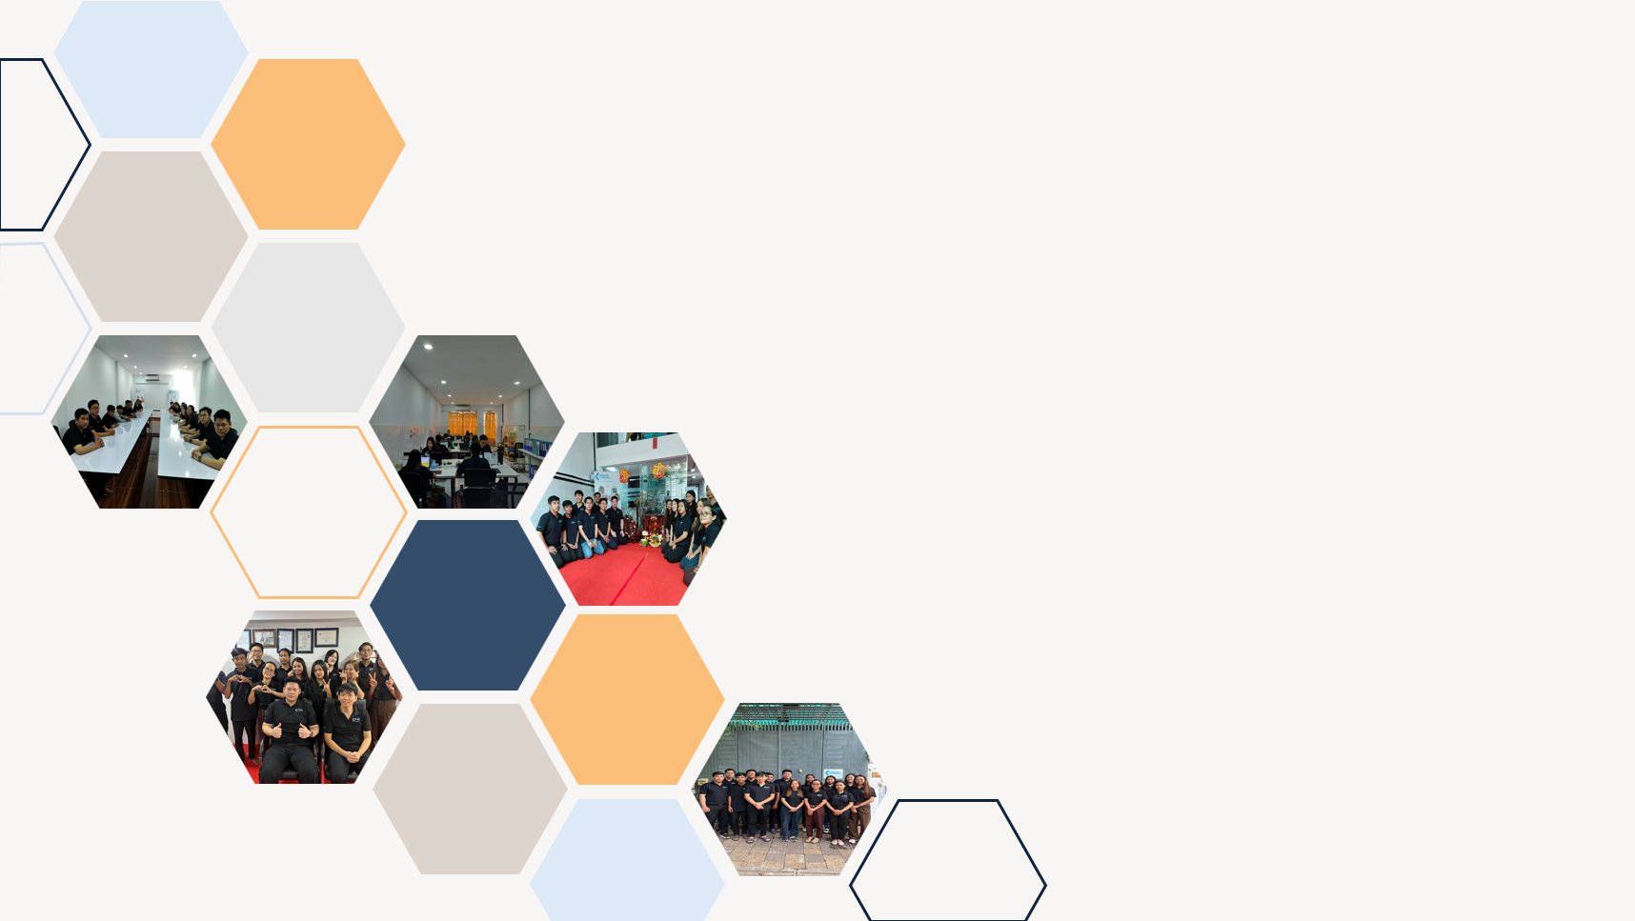

Thank you

